Slide 1
The biggest challenge for this generation of educators: Raising attainment of disadvantaged students and closing the gap
Michigan State University visit to the UK
16 October 2016
John Dunford
National Pupil Premium Champion, England, 2013-15

Slide 2
The pupil premium
The pupil premium is additional funding for publicly funded schools in England to raise the attainment of disadvantaged pupils of all abilities and to close the gaps between them and their peers.
In 2016-17, schools receive PP funding for each child registered as eligible for free school meals at any point in the last 6 years:
£1,320 for pupils in reception year to year 6
£935 for pupils in year 7 to year 11
£1,900 for each pupil in care or adopted. Funding for these pupils is managed by the virtual school head (VSH) in the local authority that looks after the child.
These sums have grown to the present level since 2011

Slide 3
Gap and disadvantaged attainment at 11: 2015
Attainment at 11 = Level 4+ in Reading, Writing, Maths
 | Gap at 11 | Attain-ment |  | Gap at 11 | Attain-ment
North East | 16 | 72 | Newham | 3 | 82
North West | 16 | 71 | Greenwich | 8 | 83
Yorkshire | 18 | 66 | Birmingham | 11 | 72
East Mids | 17 | 67 | Redcar | 14 | 78
West Mids | 15 | 69 | Doncaster | 19 | 62
East | 18 | 66 | Wakefield | 22 | 62
Inner London | 9 | 80 | Norfolk | 18 | 63
Outer London | 12 | 76 | Wokingham | 26 | 62
South East | 18 | 67 | Buckingham | 23 | 63
South West | 18 | 67 | National | 15 | 70

Slide 4
Gap and disadvantaged attainment at 16: 2015
Attainment at 11 = Level 4+ in Reading, Writing, Maths
 | Gap at 16 | Attain-ment |  | Gap at 16 | Attain-ment
North East | 30 | 35 | Tower Hmlts | 10 | 62
North West | 32 | 34 | Hounslow | 21 | 51
Yorkshire | 31 | 33 | Birmingham | 23 | 42
East Mids | 29 | 32 | Redcar | 33 | 32
West Mids | 28 | 36 | Doncaster | 31 | 29
East | 30 | 35 | Wakefield | 37 | 33
Inner London | 17 | 52 | Shropshire | 34 | 29
Outer London | 22 | 45 | Wokingham | 29 | 42
South East | 34 | 33 | Kent | 34 | 31
South West | 31 | 34 | National | 28 | 37

Slide 5
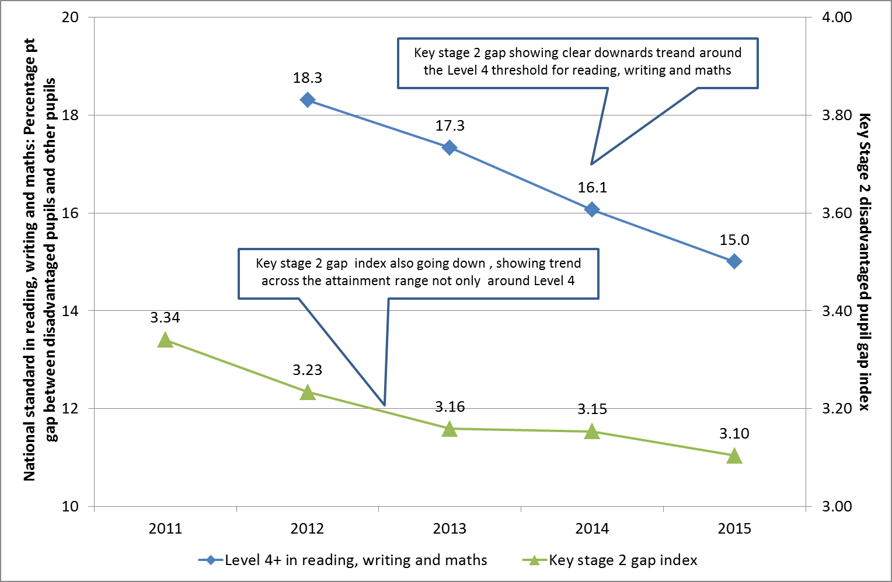
Story so far: Key Stage 2 gap since 2011…

Slide 6
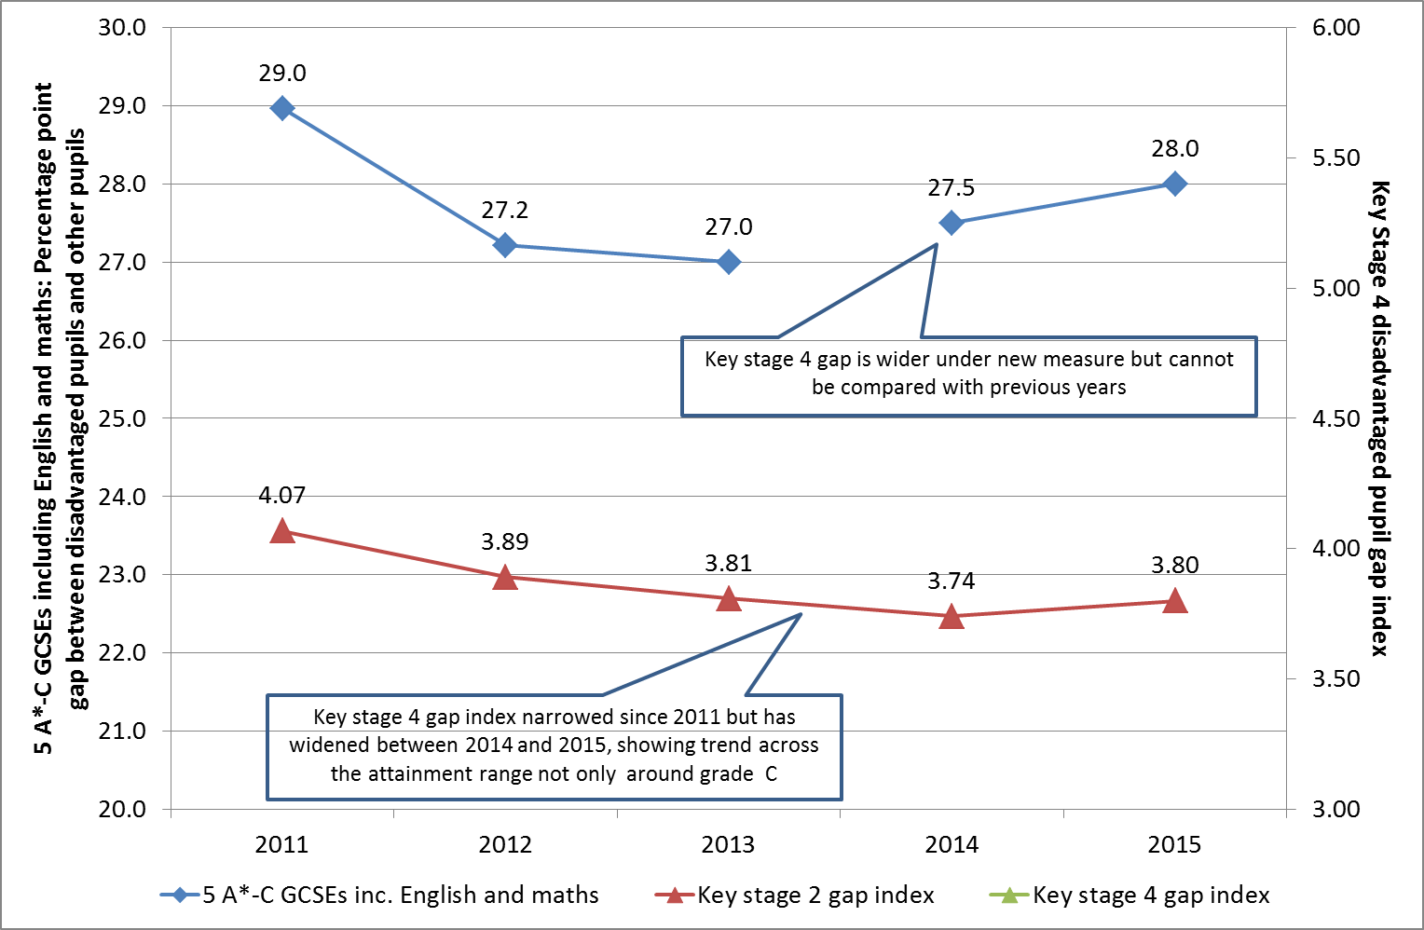
… and Key Stage 4 gap since 2011

Slide 7
V I P
Values
Innovation
Partnership

Slide 8
The ambition
“The most advanced education systems now set ambitious goals for all students, with a clear focus on equity, and are clear about what students should be able to do.”
“Excellence and equity in student performance are less related to a country’s income or expenditure on education than to how those educational resources are allocated, and to the policies, practices and learning environments that determine the conditions in which students work.”
Equity, Excellence and Inclusiveness in Education Policy: Lessons from Around the World’ , Andreas Schleicher, OECD, 2014

Slide 9
The priorities
Excellence
and
Equity
Raising achievement
and
Closing the gap

Slide 10
Attainment
PP pupils
Other pupils
Time

Slide 11
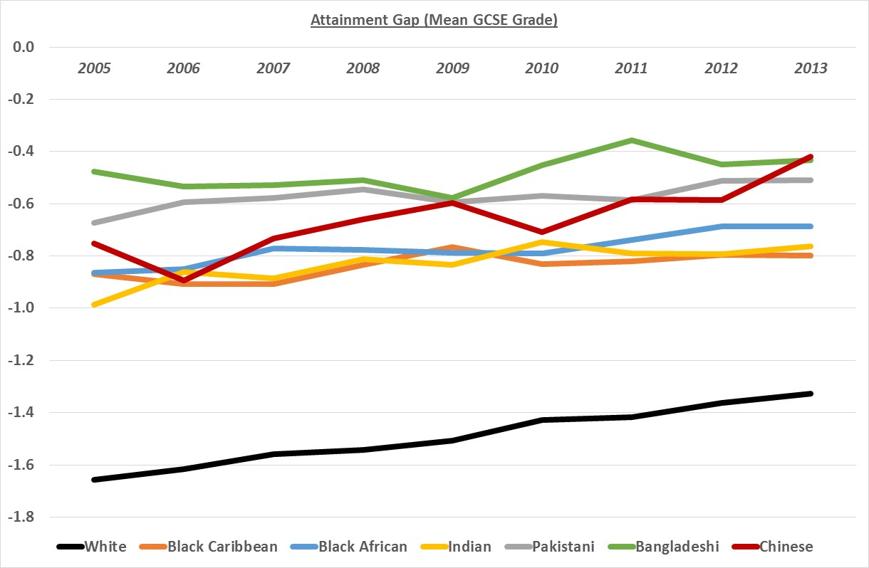
Gaps and Ethnicity / EAL

Slide 12
Missing talent
Sutton Trust report, June 2015
http://www.suttontrust.com/researcharchive/missing-talent/
Key findings:
15% of highly able pupils who score in the top 10% nationally at age 11 fail to achieve in the top 25% at GCSE
Boys, and particularly pupil premium eligible boys, are most likely to be in this missing talent group
Highly able pupil premium pupils achieve half a grade less than other highly able pupils, on average, with a very long tail to underachievement
Highly able pupil premium pupils are less likely to be taking GCSEs in history, geography, triple sciences or a language

Slide 13
Looked-after children: some statistics
68% of looked-after children achieved level 4 in reading, compared with 89% of others.
The gap at 11 is even larger in writing and mathematics.
12% of looked-after children achieved 5+ GCSEs at A*-CEM, compared with 53% of others.
33% of care leavers become NEET, compared with 13% of all young people.
6% of care leavers go to university, compared with 40% of others.
This is less than the percentage of care leavers who go to prison.
67% of looked-after children have SEN cf. 18% of the total population. Of those, 29% have a statement cf. 2.8% of all children.
62% of children become looked-after as a result of abuse or neglect and they have a much higher incidence of mental health problems.
Looked-after children especially need our additional support to achieve their potential and improve their life chances.

Slide 14
School focus for the pupil premium
Gaps, other than disadvantaged
Decide on comparators for PP students
PP / Non-PP in your school
PP in your school / Non-PP pupils nationally
Raising ambition:
In 17% of schools, FSM attainment is above the national average for ALL pupils
Use evidence of what works
Use curriculum to raise FSM attainment
Improve transition, especially for disadvantaged
Focus relentlessly on the quality of teaching and learning

Slide 15
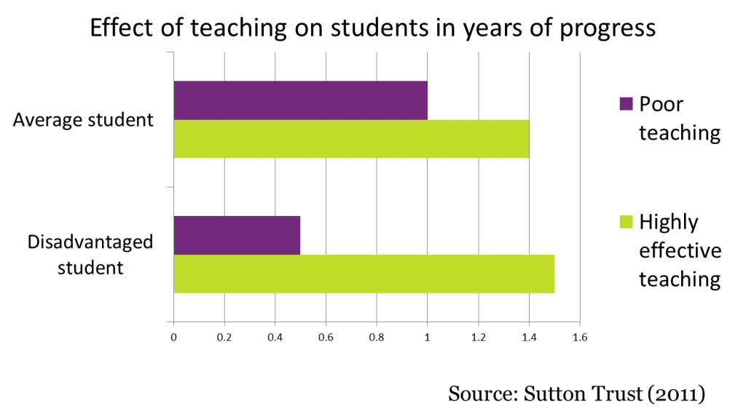

Slide 16
Strategic approach
Identify barriers to learning for PP pupils
Decide your desired outcomes
Identify success criteria for each outcome
Choose your PP strategies
Implement strategies with in-depth training
Evaluate strategies regularly
Tell the story: create an audit trail

Slide 17
Identifying the barriers to learning for PP pupils
What are the barriers to learning for the school’s PP pupils?

Slide 18
Identifying the barriers to learning for PP pupils through ….
Learning walks
PP student shadowing
PP student voice
Achievement and attendance analysis
Parent views
SLT, staff and governor views

Slide 19
Deciding on the school’s desired outcomes
Desired outcomes | Success criteria
Improving FSM attainment
Reducing gaps
Improving attendance
Accelerating progress
Reducing exclusions
Improving behaviour
Improving engagement of families
Developing skills and personal qualities
Extending opportunities
Improving transition
Good destination data

Slide 20
Choosing the school’s strategies
What strategies will produce these desired outcomes and help the school achieve its success criteria?
“Individual need, classroom rigour”
Use evidence of what works
Train staff in depth on chosen strategies

Slide 21
Evaluating the school’s strategies
External review and school self-review are both important
Evaluate impact of strategies
http://tscouncil.org.uk/guide-effective-pupil-premium-reviews/
Find a pupil premium reviewer
http://apps.nationalcollege.org.uk/closing_the_gap/create_xls.cfm
Compare your school’s PP performance with like schools http://educationendowmentfoundation.org.uk/toolkit/families-of-schools/

Slide 22
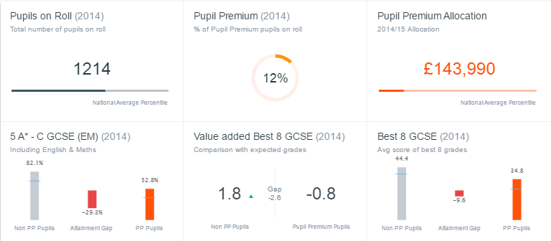
The Families of Schools Database

Slide 23
Evaluating school strategies: getting the balance right
Short-term
Long-term
Needs of individual pupils
Whole-school strategies
Teaching and learning strategies
Improving numeracy and literacy
Improving test and exam results
Raising aspirations
Pastoral support strategies
Is the balance right in the school?

Slide 24
Creating a good audit trail
The audit trail
PP funding
Strategies adopted
Implementation
Monitoring mechanisms and results
Measured impact
Evaluating each strategy: ‘What does this mean?’
Improving: ‘What do we do now?’
How good is the audit trail in the school?

Slide 25
Audit trail on the school website
 | Person responsible | Cost | Evaluation | Impact
Improve feedback
1:1 tuition
Attendance officer
Peer tutoring
etc
Plus case studies of impact on (anon) individual pupils
How good is the audit trail in the school?

Slide 26
The opportunity
Don’t wait for politicians to tell you what to do
The government isn’t telling schools how to close the gap
It’s for schools to decide how to use PP
Stop looking up and start looking out

Slide 27
Choosing strategies
Raise
attainment
Improve
quality of teaching
Early interventions
Top
EEF
strategies
Individual support
Data monitoring
Opportunities for bright pupils
Improve skills
Broaden opportunities

Slide 28
The evidence
Seek out excellent practice in other schools www.pupilpremiumawards.co.uk
Use the Education Endowment Foundation toolkit http://educationendowmentfoundation.org.uk/toolkit/
Use the NFER report on success and good practice
www.nfer.ac.uk/publications/PUPP01
Use conclusions from Ofsted surveys http://www.ofsted.gov.uk/resources/pupil-premium-how-schools-are-spending-funding-successfully-maximise-achievement

Slide 29
Professional networks
Seek out excellent practice in closing the gap
Local, regional, national, international evidence
Is there an outward-looking pupil premium co-ordinators’ network locally?
How good are the networks of key PP staff?

Slide 30
EEF Toolkit Strategies
Arts participation
Aspiration interventions
Behaviour interventions
Block scheduling
Collaborative learning
Digital technology
Early years intervention
Extending school time
Feedback
Homework (Primary)
Homework (Secondary)
Individualised instruction
Learning styles
Mastery learning
Mentoring
Meta-cognition and self-regulation
One to one tuition
18. Oral language interventions
19. Outdoor adventure learning
20. Parental involvement
21. Peer tutoring
22. Performance pay
23. Phonics
24. Physical environment
25. Reading comprehension strategies
26. Reducing class size
27. Repeating a year
28. School uniform
29. Setting or streaming
30. Small group tuition
31. Social and emotional learning
32. Sports participation
33. Summer schools
34. Teaching assistants

Slide 31
EEF Toolkit Strategies
LOW IMPACT HIGH COST
HIGH IMPACT HIGH COST
LOW IMPACT LOW COST
HIGH IMPACT LOW COST

Slide 32
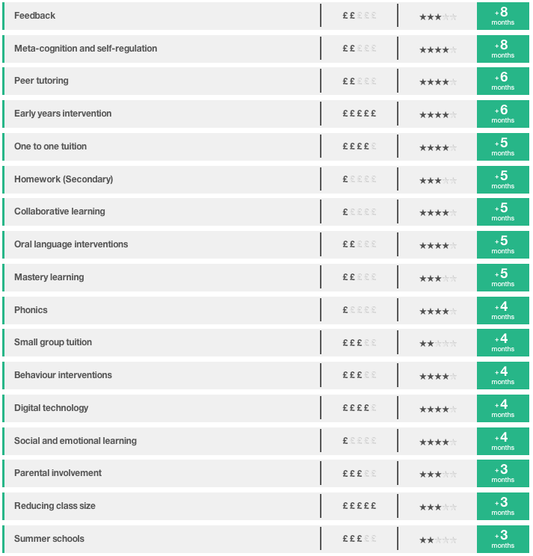
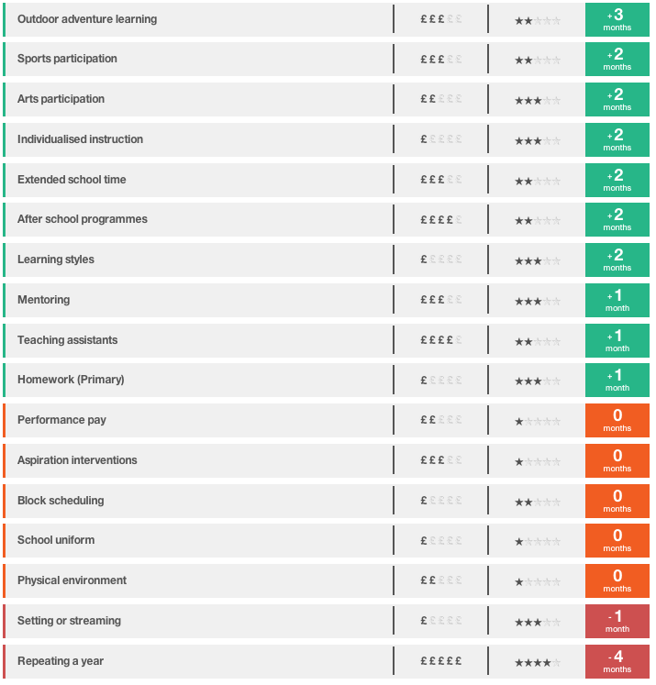
EEF Toolkit

Slide 33
Small group tuition
Approach | Average impact | Cost | Evidence estimate | Summary
Small group tuition | 4 months | £££ |  | High impact for moderate cost
Intensive tuition in small groups is very effective, particularly when pupils are grouped according to current level of attainment or specific need. Have you considered how you will organise the groups?
How will you assess pupils’ needs accurately and provide work at a challenging level with effective feedback and support?
One to one tuition and small group tuition are effective interventions. However, the cost effectiveness of one-to-two and one-to-three indicates that greater use of these approaches would be productive in schools.
Have you considered how you will provide training and support for those leading the small group tuition, and how you will evaluate the impact of it? These are likely to increase the effectiveness of small group tuition.

Slide 34
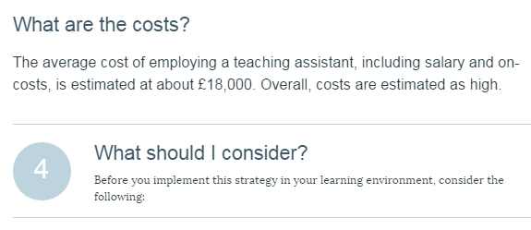
The ‘second page’

Slide 35
Using teaching assistants effectively
The DISS project: Deployment and Impact of Support Staff www.oxfordprimary.co.uk
http://fdslive.oup.com/www.oup.com/oxed/primary/literacy/osi_teaching_assistants_report_web.pdf?region=uk
EEF report on Making Best Use of Teaching Assistants http://educationendowmentfoundation.org.uk/uploads/pdf/TA_Guidance_Report_Interactive.pdf (March 2015)
How well are the teaching assistants doing?
How do you know how effective they are?

Slide 36
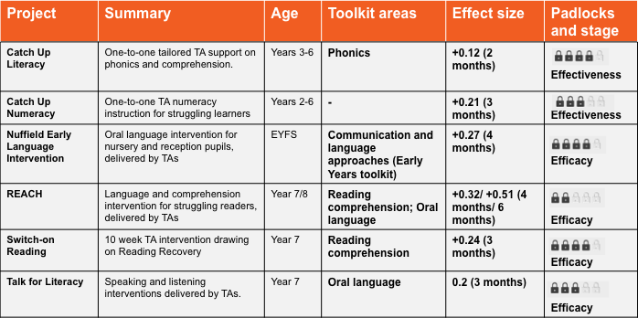
Projects: teaching assistants
Results from 6 EEF projects using TAs to deliver targeted, structured, short term literacy and numeracy interventions

Slide 37
Project | Summary | Age | Impact | Security
Accelerated Reader | A web-based programme that carefully matches books to pupils’ reading abilities | Year 7 | +3 months
Catch Up Literacy | One-to-one tailored TA support on phonics and comprehension. | Years 3-6 | +2 months
Fresh Start | A phonics programme for older children. | Year 6 & 7 | +3 months
Grammar for Writing | Improving writing through contextualised grammar teaching to whole classes. | Year 6 | +2 months
Graduate Coaching Programme | Employing coaches to improve the literacy of struggling Year 7s | Year 7 | +5 months
Switch-on Reading | 10 week TA intervention based on Reading Recovery | Year 7 | +3 months
Talk for Literacy | Speaking and listening interventions delivered by TAs | Year 7 | +3 months
Using Self-regulation to improve writing | Whole-class structured writing programme using memorable experiences as inspiration | Year 6 & 7 | +9 months
Results from a selection of EEF projects which aimed to improve literacy

Slide 38
Building blocks of success with PP
School culture
An ethos of attainment for all pupils
An unerring focus on high quality teaching
High aspirations and expectations
100 per cent buy-in from all staff
Evidence (especially the EEF Toolkit) is used to decide on which strategies are likely to be most effective in overcoming the barriers to learning of disadvantaged pupils. Particular consideration is given to high-impact, low-cost strategies.
Able to demonstrate positive impact of all strategies
In-depth training for all staff on chosen strategies
Every effort is made to engage parents/ carers in the education and progress of their child

Slide 39
Building blocks of success with PP
Individual support
Identification of the main barriers to learning for disadvantaged pupils
Individualised approach to addressing barriers to learning and emotional support
Focus on outcomes for all individual pupils
Frequent monitoring of the progress of every disadvantaged pupil
When a pupil’s progress slows, interventions are put in place rapidly
Teachers know which pupils are eligible for pupil premium
The needs are recognised of disadvantaged children in specific groups, e.g. high ability pupils, looked-after children

Slide 40
Building blocks of success with PP
School organisation
Deployment of the best staff to support disadvantaged pupils
Excellent collection, analysis and use of data relating to individual pupils and groups
Performance management is used to reinforce the importance of this agenda
Effectiveness of teaching assistants is improved through training and better deployment
Governors are trained on pupil premium
Pupil premium funding is ring-fenced to spend on the target group
Effectiveness of interventions is evaluated frequently and adjustments made as necessary
A senior leader has oversight of PP

Slide 41
Accountability
Use accountability to support successful implementation
Accountability must be for impact
Accountability to central government, to inspectors and to local authorities and governing bodies
What kind of internal school accountability will work best?
Encourage schools to build their own data sets
A key accountability question for schools to ask themselves: Are all your disadvantaged pupils making at least good progress?
A good audit trail
Accountability direct to parents
Are all pupils making at least good progress?

Slide 42
What inspectors are looking for
Before the inspection, RAISE Online is studied for evidence on gaps:
How well did FSM pupils attain last year in comparison to other pupils in the school and nationally?
How much progress did FSM pupils make last year compared to other pupils in the school and nationally?
How well have FSM pupils been performing over time? Is attainment rising? Is the gap narrowing?
PP pupil tracking by inspector
Discussions with PP pupils, parents, staff and governors
Study of effectiveness of PP spending strategies
Study of effectiveness of leadership in monitoring and evaluation
Governor involvement

Slide 43
Factors considered by inspectors
Quality of the school’s analysis of the performance and needs of PP pupils
School rationale for spending PP funding
Appropriateness and level of challenge of school’s success criteria
Robustness of monitoring and evaluation
Level of involvement of governors
Level of involvement of pupils, parents and carers
Impact on narrowing the gap

Slide 44
Accountability to parents
New regulations
https://www.gov.uk/guidance/what-maintained-schools-must-publish-online
https://www.gov.uk/guidance/what-academies-free-schools-and-colleges-should-publish-online
Obligation to report to parents on barriers to learning, PP policies and impact
Publish an online account of PP amount and plans to spend it
For previous year, publish what you spent it on and the impact

Slide 45
The moral purpose
“Our data shows that it doesn’t matter if you go to a school in Britain, Finland or Japan, students from a privileged background tend to do well everywhere. What really distinguishes education systems is their capacity to deploy resources where they can make the biggest difference.
“Your effect as a teacher is a lot bigger for a student who doesn’t have a privileged background than for a student who has lots of educational resources”
Andreas Schleicher, Times Educational Supplement, 2013

Slide 46
Disseminating PP policy and practice
There are some common barriers to learning, but every disadvantaged learner is different, so ….
Effective disadvantage attainment policy is different in every school
“Individual need, classroom rigour”
Regional strategy cannot be top-down
It has to be a bottom-up enabling strategy
It needs to empower schools to raise their ambition for disadvantaged children
So, what do schools need help with?

Slide 47
Disseminating PP policy and practice
School leaders and governors need support to:
identify barriers to learning;
develop an optimum strategy to overcome these barriers;
use data effectively;
learn what is working well elsewhere;
use evidence and adapt to their own context;
be brave and innovative;
improve the quality of teaching;
support specific groups, e.g. bright disadvantaged learners, looked-after children;
develop curriculum to raise attainment of disadvantaged chn;
monitor and evaluate the effectiveness of these policies;
report impact
What other support do schools need?

Slide 48
The challenge of dissemination
How can schools best hear the messages about the evidence and about good and outstanding practice?
Where is the best practice in the area?
How can schools best be brought into contact with this?
Should Pupil Premium Reviews be the core of dissemination work?
School leaders and governors

Slide 49
Essential documents
The main page of the EEF Toolkit, with the strategies in order of effectiveness: http://educationendowmentfoundation.org.uk/toolkit/
Page 3 of the Ofsted report on PP (Feb 2013), which summarised the successful and unsuccessful approaches to using PP
https://www.gov.uk/government/publications/the-pupil-premium-how-schools-are-spending-the-funding-successfully
The report on the Deployment and Impact of Support Staff (DISS) project on teaching assistants: www.oxfordprimary.co.ukhttp://fdslive.oup.com/www.oup.com/oxed/primary/literacy/osi_teaching_assistants_report_web.pdf?region=uk
EEF report on the effective use of teaching assistants (February 2015) at http://educationendowmentfoundation.org.uk/uploads/pdf/TA_Guidance_Report_Interactive.pdf
Ofsted resource on evaluation of pupil premium effectiveness https://www.gov.uk/government/publications/the-pupil-premium-analysis-and-challenge-tools-for-schools

Slide 50
Essential documents
Article for middle leaders from the Spring 2014 of Teaching Leaders Quarterly: http://www.teachingleaders.org.uk/wp-content/uploads/2014/03/TL_Quarterly_Q5_14_Dunford.pdf
Blogs: Ten point plan on spending the pupil premiuhttp://johndunfordconsulting.wordpress.com/ and summary (September 2015)
Education Endowment Foundation tool for comparing PP performance of each secondary school within its family of 50 most-like schools http://educationendowmentfoundation.org.uk/toolkit/families-of-schools/
Guidance on conducting Pupil Premium reviews. Also useful for doing school self-review of PP strategies (Published December 2014)
http://tscouncil.org.uk/guide-effective-pupil-premium-reviews/
NFER report on successful practice with pupil premium (Published Nov 2015) www.nfer.ac.uk/publications/PUPP01
Education Policy Institute report - Divergent Pathways: the Disadvantage Gap, Accountability and the Pupil Premium (2016) http://epi.org.uk/wpcontent/uploads/2016/07/disadvantage-report.pdf

Slide 51
Essential documents
See also:
Ofsted report on Unseen Children: http://www.ofsted.gov.uk/resources/unseen-children-access-and-achievement-20-years
A link to the Free School Meals toolkit, which give practical ideas for increasing registration:
http://www.childrensfoodtrust.org.uk/resources/fsm/free-school-meals-matter-toolkit
National Audit Office report on PP (June 2015) http://www.nao.org.uk/report/funding-for-disadvantaged-pupils/

Slide 53
Contact John Dunford at
jd@johndunfordconsulting.co.uk
www.johndunfordconsulting.co.uk
Twitter: @johndunford
Blog: http://johndunfordconsulting.wordpress.com/
http://www.johncattbookshop.com/the-school-leadership-journey
www.wholeeducation.org

