Slide 1
GMTC Infrastructure and Places
Identified Funding Gaps

Slide 2
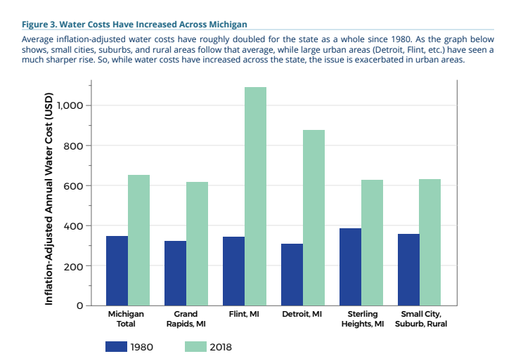
Water: Change in Water Rates over Time
UM’s Statewide Water Affordability Assessment Report
Notes:
https://graham.umich.edu/media/files/MI-statewide-water-affordability-assessment-report.pdf

Slide 3
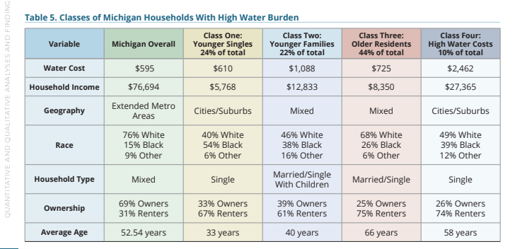
Water: Water Burden across Different Population Segments

Slide 4
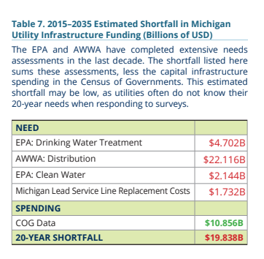
Water: Gap in Funding

Slide 5
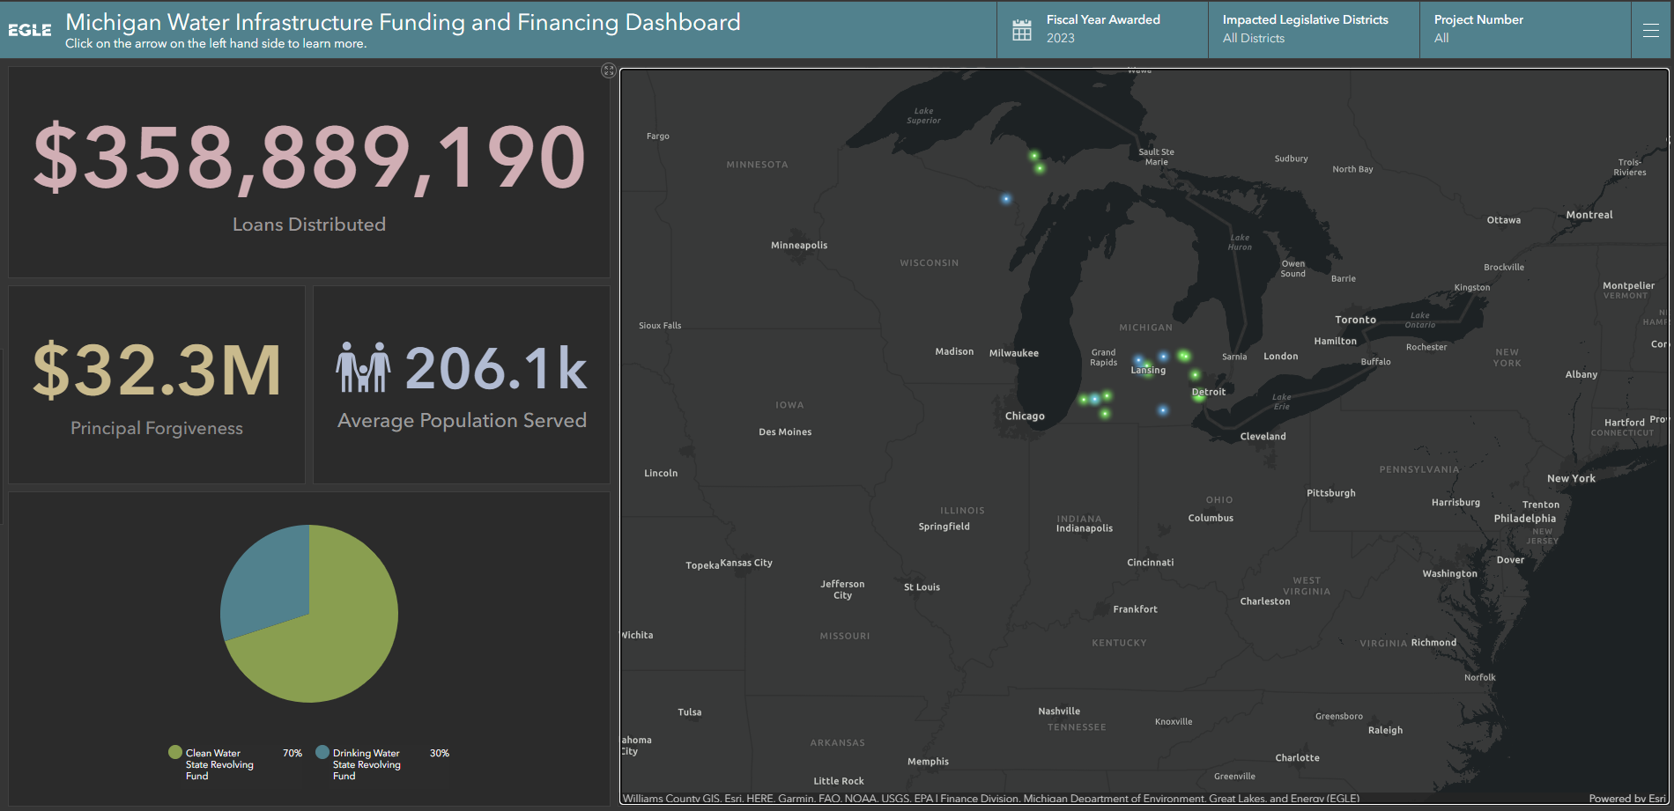
2023 State of Michigan SRF Funding Allocation

Slide 6
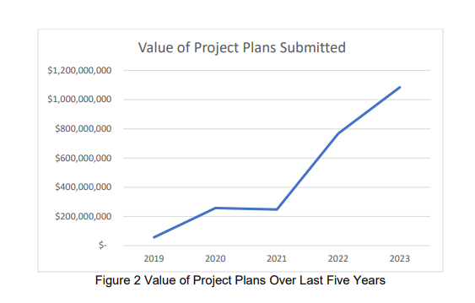
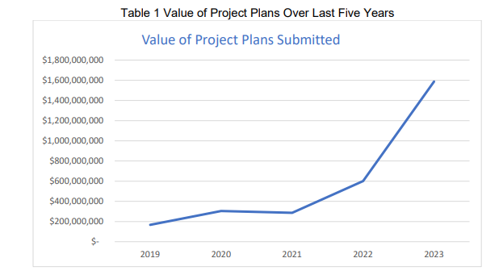
CWSRF
CWSRF
DWSRF
Notes:
Michigan’s CWSRF program has allocated over $5.7 billion in low interest loans to over 670 projects around the State since 1988. Of that amount, $106 million has been awarded as loan principal forgiveness since 2010. Over the past five years WIFFS has seen a significant uptick in the number of municipalities interested in applying for CWSRF dollars, from just over $150 million in 2019 to over $1.5 billion in requests for fiscal year (FY)2023 dollars

Slide 7
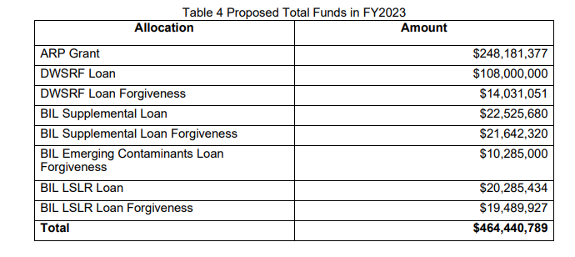
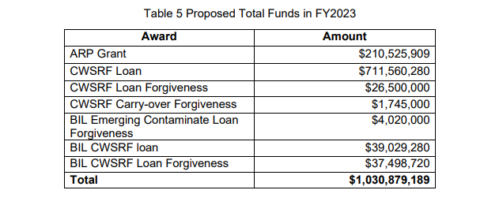
CWSRF and DWSRF FY 2023 Funds
Drinking Water
Clean Water
Total Requests: 110; Total Value: $981,610,000
Total Requests: 69; Total Value: $1,646,761,629
Notes:
$ 981,610,000

Slide 8
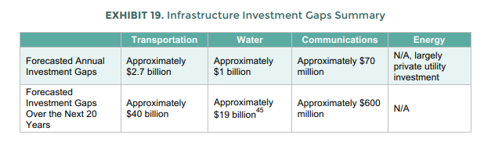
2016 Infrastructure Investment Gap

Slide 9
Road Funding Revenue (actual and estimated)

Slide 10
Previous Estimates
Combined Annual Estimated Cost of Preserving Michigan’s Road Network, MDOT and CRA
Road Type | Annual Average | Lane Miles | Percent of Road Network
Federal-aid roads Total | $4,940,000,000 | 85,590 | 33.4%
MDOT-owned federal-aid roads | $2,476,000,000 | 27,366 | 10.7%
Locally owned federal-aid roads | $2,464,000,000 | 58,224 | 22.7%
Non-federal-aid roads, CRA (15 percent per year) | $2,245,676,838 | 170,704 | 66.6%
MDOT and CRA Combined Estimated Total | $7,185,676,838 | 256,294 | 100%
Sources: MDOT November 2021b, CRA 2021, US DOT FHA 2022

Slide 11
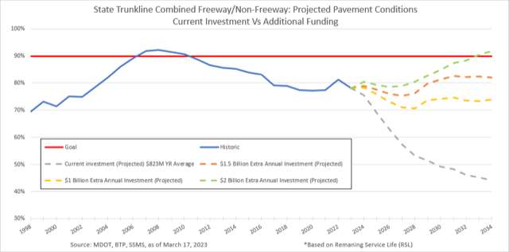
MDOT Historic and Projected Trunkline Pavement in Good or Fair Condition, 1998–2034

Slide 12
PSC-Modeled Road Network Annual Costs
PSC Calculated Road Network Cost
Breakdown of Maintenance Costs | Costs
Federal-aid Roads
Total cost per lane mile (life of the road) | $4,226,000
Average annual cost per lane mile | $86,245
Total lane miles | 83,030
Total average annual cost | $7,160,940,012
Non-federal-aid Roads
Total cost per lane mile | $557,595
Average annual cost per lane mile | $11,379
Total lane miles | 165,000
Total average annual cost | $1,877,615,816
Average annual cost of the State of Michigan road system, all roads | $9,038,555,828
Cost to maintain FEDERAL- AID lane-mile road over a 50-year lifespan
Cost to maintain a LOCAL road lane mile over a 50-year lifespan
Notes:
Assumes a road life of 49 years, 256,000
MDOT+CRA= $2 billion annually
PSC= $3.9 billion annually
PSC number assumes that the roads have a maintenance cycle that allows for almost 50 years of useful life.
That number grows to more than $11 billion over time if proper maintenance is not adhered to.

Slide 13
Estimating the Funding Gap in Michigan
Funding Gap Estimate
Funding Source |  | PSC Estimate
Average annual cost of the State of Michigan road network, federal- and non-federal-aid roads |  | $9,038,555,829
MDOT state and federal annual estimate through 2045 |  | $4,342,160,000
IIJA increase and RBMP through FY 2026 |  | $764,640,000
Average annual deficit through FY 2026 |  | $3,931,755,829
Note: These numbers are not adjusted for inflation.
This equates to an annual cost of $535 for all adults in Michigan.
Notes:
MDOT+CRA= $2 billion annually
PSC= $3.9 billion annually
PSC number assumes that the roads have a maintenance cycle that allows for almost 50 years of useful life.
That number grows to more than $11 billion over time if proper maintenance is not adhered to.

Slide 14
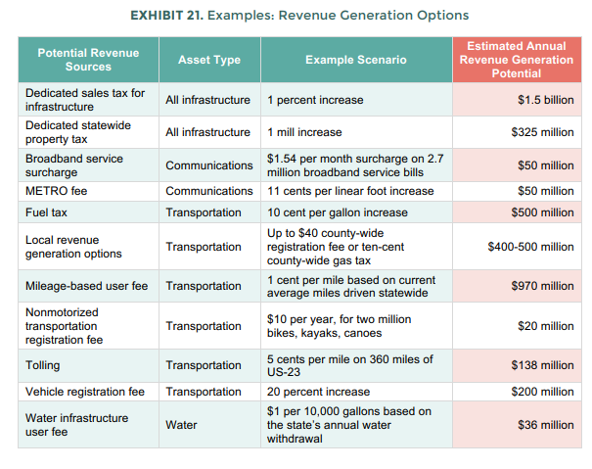
2016 21st Century Infrastructure Commission
Potential Funding Solutions
Notes:
Speak to progress with implementation here.

Slide 15
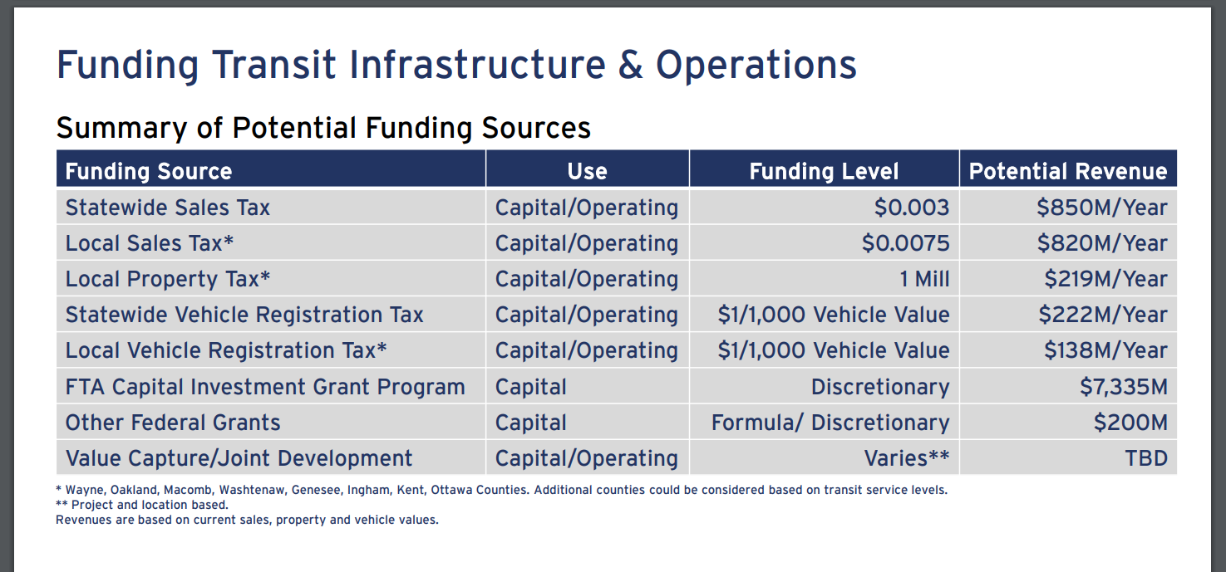
HNTB Roads Funding Needs Estimates

Slide 16
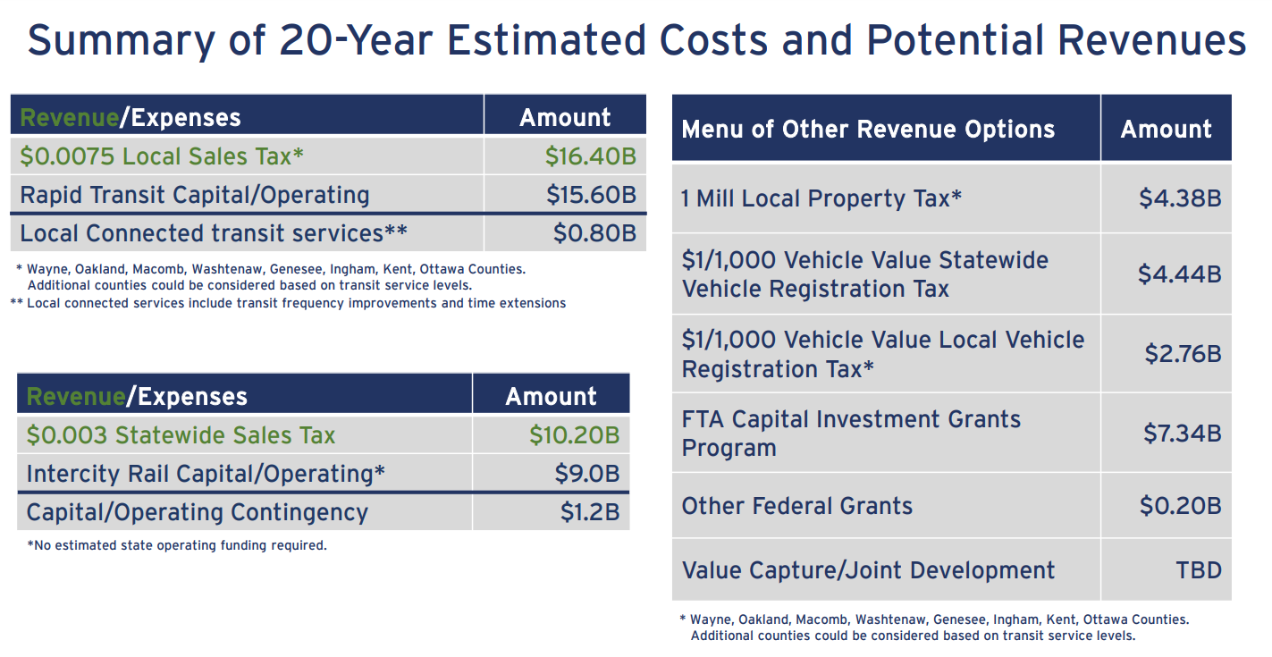
HNTB Transit Funding Options

