Slide 1
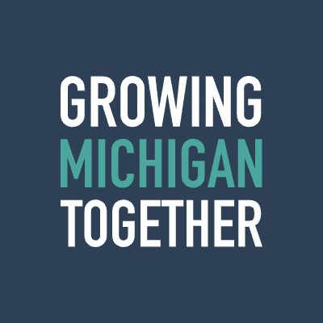
Initial perspectives | GMTC Higher Ed
BCG Presentation
July 2023

Slide 2
Growing Michigan Together Council: Higher Education Working Group
Goal: Propose long-term, sustainable, and equitable funding solutions for Michigan’s postsecondary education system, including student financial aid, to help meet the 2050 population goal identified in the report. To do so, the group will…
Consider the need to improve college access and success, lower costs, and provide education and training that meets the demands of the state’s economy
Consider and build on the existing efforts within the Office of Sixty by 30 and make recommendations to achieve and exceed this goal
Propose solutions to retain talent in the state at the critical transition point post-graduation

Slide 3
Baseline: Michigan currently lagging in attainment and credentials…
16% of MI population (1.1M people) has attended college without receiving any type of credential
      Community Colleges can help Michigan compete with best-in-class by:
Educational attainment (25 years and older) by state
4.8M
222.8M
6.9M
1.6M
Graduate or
professional degree
45.2M
0.7M
Improving retention and graduation rates to shift "some college" category into Associate degree and above
Bachelor’s degree
Associate degree
Some college
Increasing enrollment so high school graduates can earn post-secondary credentials
High School
diploma or GED
No High School diploma
Massachusetts
U.S.
Michigan
Highest levels of education attainment nationally
Certificate
Third-party industry certification
Some college, no credential
Note: Certificates denote completion of a specific educational program, whereas certifications typically require passing an exam from a third-party professional group
Source: 2016-2020 American Community Survey Five-year Estimates, Lumina Foundation

Slide 4
Baseline: With opportunity for progress in credentials to provide opportunities for Michiganders to fill high-demand positions in the workforce
2019 analysis of occupational supply and demand in the Michigan labor market
562,590
1%
1,369,330
Oversupply
Undersupply
8%
2%
Associate Degree
High School Diploma
Balanced
Postsecondary
Nondegree Award
Doctoral or Professional Degree
Bachelor’s Degree
No Formal Educational Credential
Note: Represents top 15 occupations for key industries (Agriculture, Construction, Energy, Healthcare, Information Technology, and Manufacturing)
Source: Department of Technology, Management and Budget, Bureau of Labor Market Information and Strategic Initiatives - Industry Cluster Workforce Analysis

Slide 5
Baseline: Michigan's enrollment is declining faster than national average and opportunity for increased completion rates in 2-year institutions
4-year institutions
2-year institutions
420,500
10-year CAGR
2020-21 YoY change
189,900
10-year CAGR
2020-21 YoY change
students enrolled at
4-year higher education institutions in 2020-21
students enrolled at
2-year community colleges in 2020-21
MI
-2.2%
-4.5%
MI
-5.6%
-8.6%
US
-1.5%
-2.8%
US
-2.7%
-7.1%
61%
27%
6-year completion
rate at 4-year higher education institutions
Michigan is performing on par with the 61% national average
completion rate at
2-year community colleges
Michigan is performing behind the 38% national average
Note: 2-yr and 4-yr designation based on IPEDS classification
Source: National Center for Education Statistics – Integrated Postsecondary Education Data System; Business Leaders for Michigan

Slide 6
Baseline: Michigan average cost of education often higher than national average, though loan debt in-line
MI 4-year institutions
MI 2-year institutions
Public
Public
  $12,000 average annual tuition & fees
  85.6% of students receiving financial aid
  $10,538 average scholarships/grants awarded
  $7,024 average federal student loan award
  $6,460 average annual tuition & fees
  78.4% of students receiving financial aid
  $4,955 average scholarships/grants awarded
  $4,625 average federal student loan award
Private
Private
  $29,563 average annual tuition & fees
  99% of students receiving financial aid
  $23,549 average scholarships/grants awarded
  $7,323 average federal student loan award
  $20,312 average annual tuition & fees
  85.9% of students receiving financial aid
  $6,518 average scholarships/grants awarded
  $7,800 average federal student loan award
$29,863
avg. student loan debt among graduates of MI's 4-year institutions
$29,100
national avg. student loan debt among Bachelor's degree graduates of 4-year institutions
$11,704
avg. student loan debt among graduates of MI's 2-year
community colleges
$13,900
national avg. student loan debt
among graduates of 2-year
community colleges
$10,940
national avg. tuition & fees to attend public 4-year institution
$39,400
national avg. tuition & fees to attend private 4-year institution
$4,589
national avg. tuition & fees to attend public 2-year institution
$15,450
national avg. tuition & fees to
attend private 2-year college
Note: 2-yr and 4-yr designation based on IPEDS classification
1. Scholarship/grant data refers to federal/state/institutional scholarships and grants 2. Financial aid data refers to full-time, first-time undergraduate students
Source: National Center for Education Statistics – Integrated Postsecondary Education Data System; Community College Review, Institute for College Access & Success; Michigan.gov; College Board Trends in College Pricing Report

Slide 7

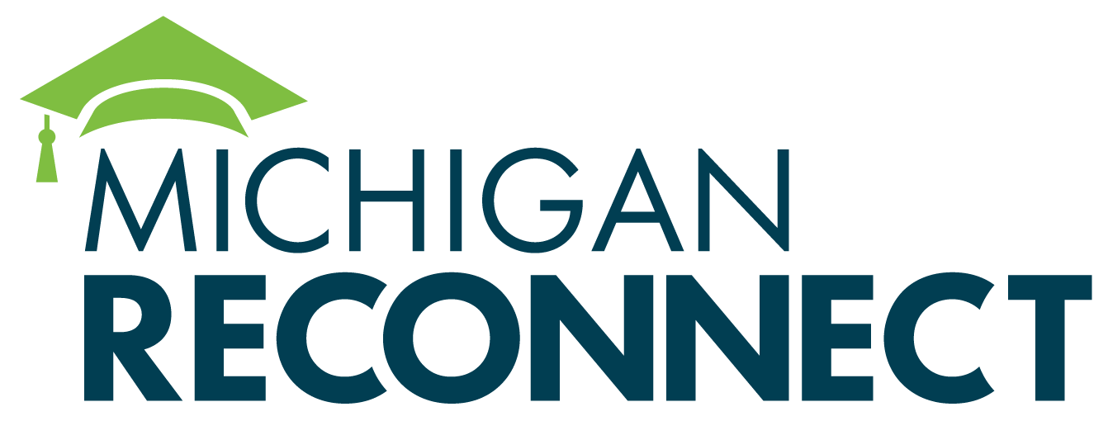
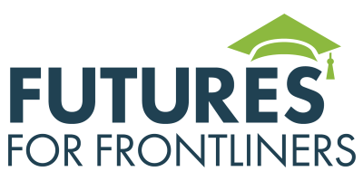

Michigan has made lifelong learning a priority for the state's future growth
      Sixty by 30
      Michigan Reconnect
      MiLEAP
      Futures for Frontliners
Statewide initiative seeking to increase the number of Michiganders with a skill certificate or college degree by 9.5% over the next
7 years
A scholarship program funding tuition-free education for Michiganders at community colleges in their home districts
New statewide Department of Lifelong Education, Advancement and Potential will include an Office of Higher Education to improve Michiganders' access and attainment of college education or skill credentials, as well as the affordability of higher education
Tuition-free community college for frontline, essential workers during the COVID-19 pandemic who do not yet have a degree or credential
Source: Michigan.gov

Slide 8

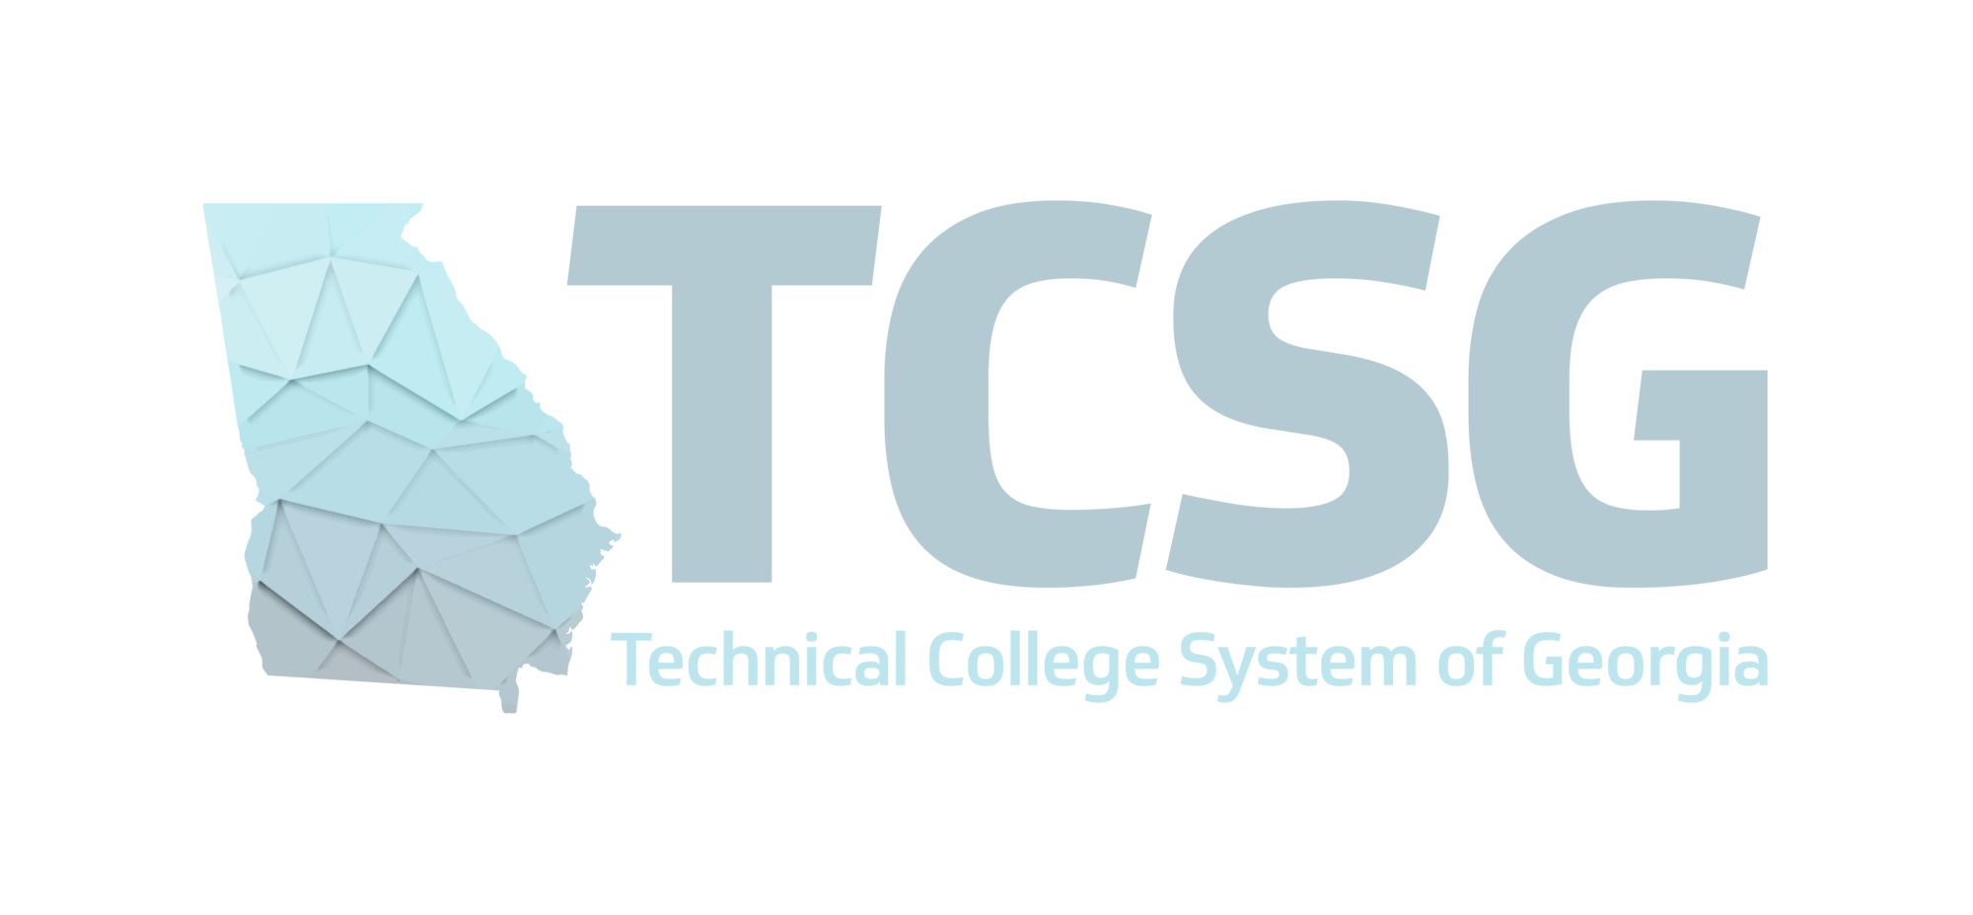


Strength of higher ed institutions is critical to pop growth & vibrancy
Student success: enrollment
and retention
Arizona State University
Student success: workforce
alignment
Technical College System of Georgia
Technology development & commercialization
University of Pennsylvania
Beyond placemaking: fostering destination cities
Georgia Institute of Technology

Slide 9

Example | Student success: enrollment and retention
Prioritization of personalized recruitment and flexibility for students; holistic support services and outreach for international students
  Recruiting initiatives focus on personalized outreach to high schools, engaging underrepresented students
w/ STEM interests, and international students (e.g., offers remote learning before joining on campus,
support CPT & pre-OPT)
  Flexible options for experiential learning (e.g., traditional internships, short-term "micro-internships," industry-based learning opportunities, and cooperative education)
Impact
Student enrollment has increased, w/more graduates staying in-state after grad
  Record enrollment numbers for the 2022-23 school year: 79,200 on-campus students enrolled, up by 3.2% from the previous year
  Ranked #1 public university for international students, w/enrollment increase of 17.5% b/w 2020-21
  Ongoing partnership with State Farm to engage non-traditional learners and solidify pipeline of data science talent from ASU Math and Statistics Master's programs
  Record enrollment at Fulton School of Engineering: 30,000 students in Fall 2022, up 12% from last year and 27% from 2017; ~70% of grads stay in Arizona
Source: ASU websites; AZ Central; Axios Phoenix

Slide 10
Deep dive | Arizona State producing 3X more engineering graduates vs. 20 years ago
      Significant growth in engineering degrees
      Growing engine to meet regional talent needs
3.4X
Share of Bachelor graduates staying in-state to start careers has increased to 67% in 2020-21, up from 59% in 2017-18
Greater share of graduates stay-in state for employment vs. in-state share of enrollment (46% of undergraduates)
10%+ annual increase degrees recently
"The 30,000 students currently enrolled in engineering programs and innovation taking place at ASU is a draw…”
- Chris Camacho, Greater Phoenix Economic Council President and CEO
2000-01
2010-11
2020-21¹
# of Bachelor and Masters degree’s awarded in engineering²
1. 2020-21 number excludes 375 degrees awarded via ASU Digital Immersion (i.e. ASU Online) to ensure comparable numbers. 2. Maps to two digit CIP code 14. Reflects in lower numbers than what school reports directly given non engineering degrees in portfolio
Source: IPEDS (data pulled July 9, 2023), Arizona State website, interviews

Slide 11

Example | Student success: workforce alignment
Georgia QuickStart program provides customized recruiting and training services to businesses looking to expand / reskill workforce
  Training programs include management and workplace success skills, workplace safety, computer skills, industrial maintenance, and others relevant to priority industries
High Demand Career Initiative incentivizes businesses to create apprenticeship opportunities for GA students
  In 2022, TCSG announced $1M to support apprenticeship creation in high-demand industries
Impact
Job placement success rate can drive enrollment increases across TCSG system, with more and better opportunities for students to enter high-demand industries
  GA QuickStart program has trained 255,650 employees since its inception, and worked with over 2,500 companies in 159 counties
  Expansion of program provides increased value to education ecosystem and is fueled by growth in colleges, e.g., South Georgia Technical College increased enrollment by 11.7%, and Wiregrass Technical College increased enrollment by 12.2% in 2021-22
Source: Technical College System of Georgia websites; Georgia QuickStart website; South GA Tech website

Slide 12

Example | Tech development and commercialization
Cultivation of a strong spirit of tech development to make
an economic impact
  Invested behind the Penn Center for Innovation (PCI), PCI Fellows and PCI Ventures,
  all aiding in the discovery and commercialization of R&D
  Provided pathways for both students (Y-Prize Comp) and alumni (Penn Venture Lab)
  to gain funds and awards
Impact
Significant recognition of Penn as an innovation hub for research and innovation, attracting
talent and business to PA
  Ranked first in technology licensing income, top #2 for research and #4 for most innovative university in the world – attracting key talent to Philadelphia
  Increased participation across multiple schools, & significant outcomes impacting broader community: over 900 patents filled by PCI, 75 companies supported, and $536M raised by PCI Venture companies since 2014
Source: University of Pennsylvania websites; Technical.ly; Philadelphia Magazine; Philadelphia Inquirer; BCG analysis

Slide 13
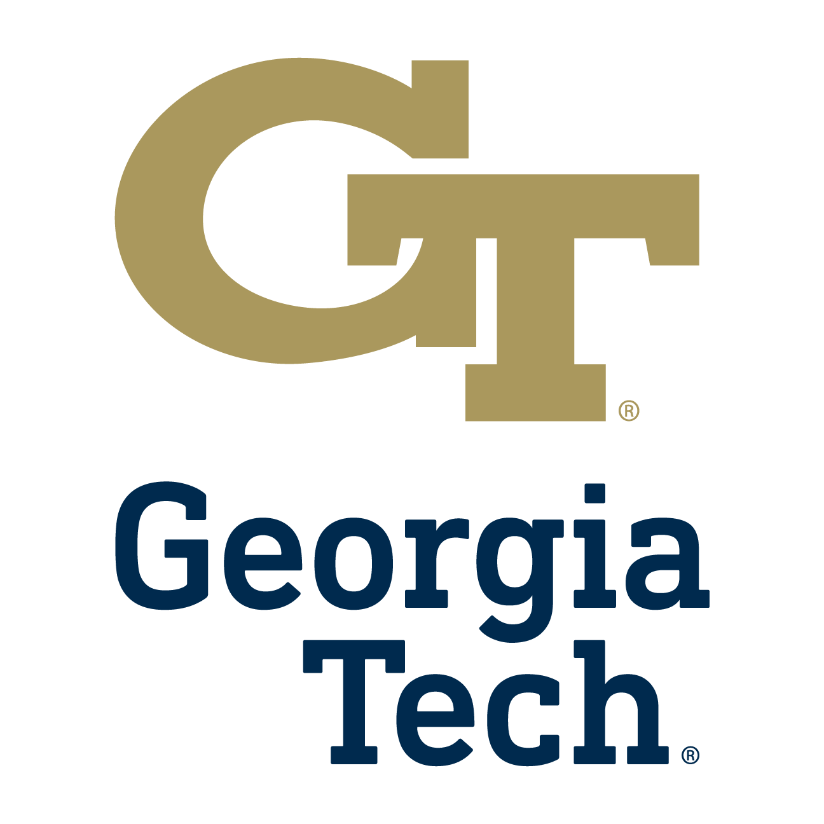
Example | Beyond placemaking; fostering destination cities
Focus on technological investment and career pathway / reskilling opportunities for
local talent
  Opened 3 technology parks: Technology Enterprise Park, Global Center for Medical Innovation, and Biolocity
  Campus intersects with the 2M square foot Technology Square Innovation District, home to the Advanced Tech Development Center business incubator and Engage Venture Fund, with 25 Atlanta and out of state companies
  and a network of 190k working professionals
Impact
Strong network of businesses, innovators, researchers, and students, positioning GT as a destination hub in the Southeast
  Technology Square has brought AT&T, Boeing, Cisco, Honeywell, and Panasonic, among 20 other large out-of-state companies to Midtown Atlanta
  Over the past 5 years, Atlanta has seen 15% growth in tech jobs – comparable with notable tech cities such as
  San Francisco¹
  More than a dozen companies that started or are based in Atlanta have grown to valuations above $1 billion
  Georgia Tech turns out the most tech graduates per year in the United States²
Source: 1. Atlanta is a growing hub for top tech companies like Apple and Microsoft to find Black talent (cnbc.com) 2. Atlanta’s tech and innovation scene heats up - Atlanta Business Chronicle (bizjournals.com)

Slide 14





Given these and other success stories, more voices across the nation making the case for the importance of higher ed for population growth
College Towns Morphing into Population Powerhouses, Shifting Political Gravity
Maybe Grad Schools Are the Way to Drive Population Growth
  College Towns in general are growing at a faster rate than the country … filling up with higher-income, college-educated urbanites who want
  the amenities of a city and the easier life of a smaller town.
The more graduate students a county has, the greater its population growth — whether you’re talking Alabama or California.
Higher Education Propels Population Growth (Probably)
Faster population growth is associated with more graduate students…. [and] this grad-school-growth association applies as much in coastal as in heartland states.
Source: American Communities Project; The Cut; Medium

Slide 15
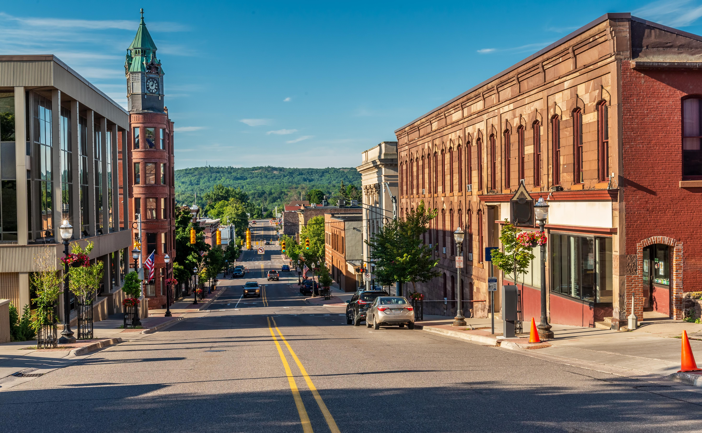

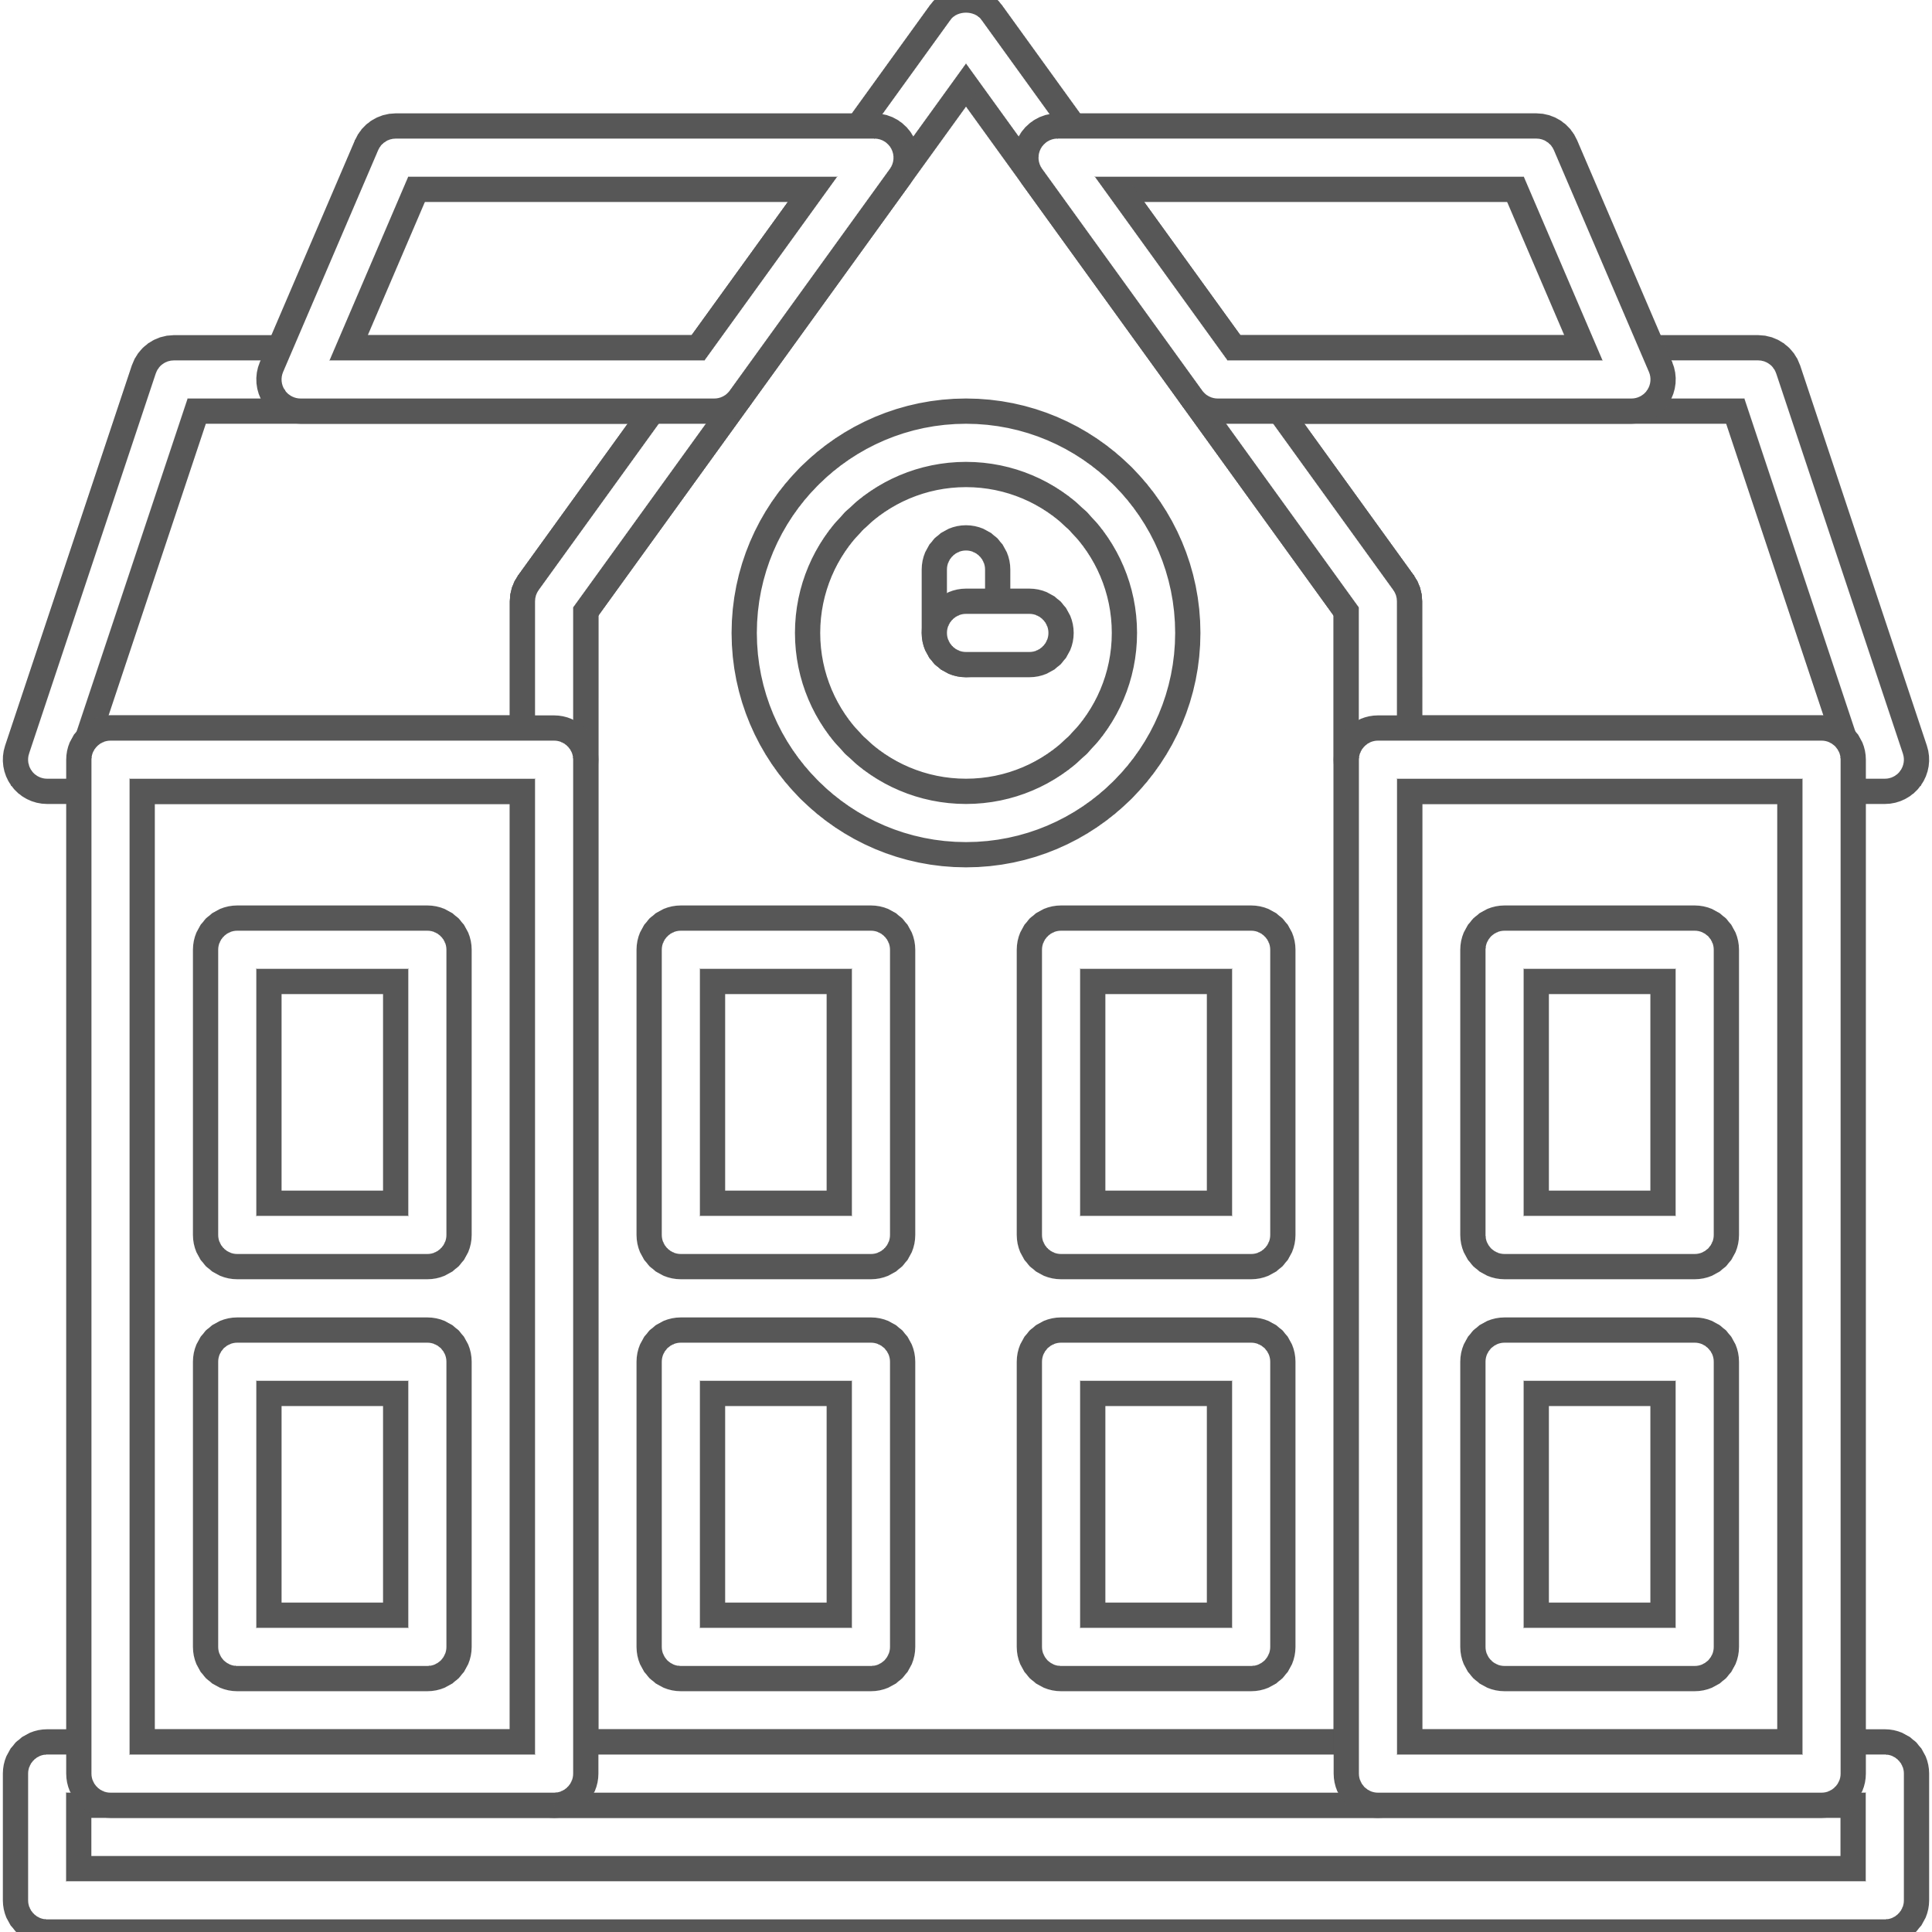




Looking inwards, Michigan has great assets to build from…
… and some areas for further development for this effort
Student success: Tradition of excellence in producing engineering and STEM graduates
  MI ranks 10th nationally for STEM degree completions; produces 4X national average of engineers
Student success – workforce: Strong program and policy focus on higher education and skilling
  E.g, "60 by 30" initiative; Michigan Reconnect; Futures for Frontliners
  E.g, EV Talent Action Team largest campaign in the nation; Michigander EV Scholars Program keeping grads in MI
Tech development: World class research institutions powering global innovation
  E.g., U of Michigan ranked #1 public research university by the National Science Foundation; Wayne State ranked #2 for medical research by US News
Beyond placemaking: Formation of innovation districts
  E.g., TechTown Detroit district anchored by Wayne State
  E.g., Planned UMCI and MI Central Innovation Districts in Detroit to potentially be biggest tech districts in MI
  Decreasing broader enrollment and completion rates among institutions
  MI community college enrollment decline exceeded national rates; majority of MI community colleges fall behind the national median for 6-year completion rates
Lack of cohesion in state operating model surrounding higher ed
  Michigan is the only state without a central coordinating group for higher education
Failure to capitalize on research commercialization & tech transfer opportunities
  U of Michigan ranks in the top 20 nationally for technology transfer, but most others behind (e.g., MSU, Michigan Tech, and WMU rank #82, #105, #119)
Innovation districts lag best-in-class exemplars
  University Research Corridor ranks behind peer districts (IL, MA, NC, PA) in licensing revenue, invention disclosures, and patents awarded
Source: Heartland Forward; Michigan's Great Inflection: A Strategy for the Age of Technology and Talent ; University Research Corridor 2023 Benchmarking report; Detroit News; Michigan Economic Development Corporation; Wayne State University website; University of Michigan website; BCG analysis

Slide 16
Thank you!

